Slide 1
Kaje Matrix
A matrix of relationships among drivers and traits of interest
Column influences row: positive=green, negative=red, uncertain=yellow
Uncertainties can be context dependent (response could be + or – depending on situation) or unknown
Conceptual tool underpinning qualitative network analysis
Boils down to a matrix of +1, -1, 0s.
 | Focal salmon populations |  |  |  |  | Salmon individuals |  |  |  |  | Foodweb |  |  |  |  |  |  |  |  |  | Water quality/quantity in Salish Sea |  |  |  |  |  |  | People |  |  |  |  |  |  |  |  |  |  |  | Climate
Survival | Survival |  |  |  | + | 1 or -1
Migration timing (out of SS) | ? | Migration Timing (out of SS) |  | + | 1 or -1 | 1 or -1 | -
Migration timing (into SS) | ? | + | Migration Timing (into SS) |  |  | -
Diversity | + | + | + | Diversity | 1 or -1
Abundance |  |  | - | + | Abundance |  | - |  | - |  | + | + | + | - | - | -
Mortality (F and M) | - |  |  | - | - | Mortality (F and M)
Residency in SS |  | + |  | + |  |  | Residency in Puget Sound | ? | ? |  | + | + | + |  | - | -
Health/Fitness |  |  |  |  |  | - | ? | Health/Fitness | +
Growth rate |  |  |  |  |  |  | - | + | Growth rate | +
Size | + |  | 1 or -1 |  |  | - | - |  | + | Size
Marine mammals | - | + |  |  |  | + | - |  |  |  | Marine Mammals |  | - | - | -
Birds | - |  |  |  |  | + |  |  |  |  |  | Birds | - | - | -
Fish predators | - |  |  |  |  | + | - |  | - |  |  |  | Fish Predators | - | - | -
Other salmon spp |  |  |  |  |  | - | - | - | - |  | + | + | + | Salmon spp | - | - | -
Forage fish | + | + |  |  |  | - | + |  | 1 or -1 |  | + | + | + | 1 or -1 | Forage fish | - | - | -
Zooplankton |  |  |  |  | + |  | + |  | + |  |  |  | + | + | + | Zooplankton |  | - | - | - | - | + | + | +
Terrestrial inverts |  |  |  |  |  |  | + |  | + |  |  |  |  | + | + |  | Terrestrial inverts
Microplankton |  |  |  |  |  |  |  |  |  |  |  |  |  |  |  | 1 or -1? |  | Microplankton | - | - | - | + | + | +
Diatoms |  |  |  |  |  |  |  |  |  |  |  |  |  |  |  | + |  | + | Diatoms | + | + | - | + | -
Microbial detritivores |  |  |  |  |  |  |  |  |  |  |  |  |  |  |  | + |  | + |  | Microbial Detritivores | - | + | + | -
DO |  |  |  |  |  | - | + |  | + |  |  |  | + | + | + | + |  |  |  |  | DO
Dissolved CO2 |  |  |  |  |  |  | - | - | - |  |  |  |  |  |  | - |  | - | + | - |  | CO2 |  |  |  |  |  |  |  |  |  |  | +
Turbidity |  |  |  |  |  | - | + |  |  |  |  |  |  |  |  |  |  |  | - |  |  |  | Turbidity
Nutrients |  |  |  |  |  |  |  |  |  |  |  |  |  |  |  |  |  | + | + | + |  |  |  | Nutrients (Salish Sea)
Temperature-SST |  |  |  |  |  |  | often - |  | 1 or -1 |  |  |  |  |  | 1 or -1? | 1 or -1? |  | + | + | + | - |  |  |  | Temp-SST | + |  |  |  |  |  |  |  |  |  | -
Stratification |  |  |  |  |  |  |  |  |  |  |  |  |  |  |  |  |  | + | 1 or -1? | + |  |  |  | - | + | Stratification
River flow |  |  |  |  |  |  |  |  |  |  |  |  |  |  |  | 1 or -1? | + |  |  |  |  |  | + |  |  | + | River flow |  |  |  |  |  |  | -
Conservation policy |  |  |  |  |  |  |  |  |  |  | + | + |  |  |  |  |  |  |  |  |  |  |  |  |  |  |  | Conservation policy | - | - | - | - |  | - | - | - |  | -
Contaminants |  |  |  |  |  |  | - | - | - |  | - | - | - |  | - | - | - |  |  |  |  |  |  |  |  |  |  |  | Contaminants |  |  |  |  |  |  | -
Estuarine/shoreline habitat loss |  |  |  |  |  |  | - |  |  |  |  |  |  |  | - | - | - |  |  |  |  |  | - |  |  |  |  |  |  | Estuarine/shoreline habitat loss
FW habitat loss |  | - |  | - | - |  | - |  |  |  |  |  |  |  |  |  |  |  |  |  |  |  | 1 or -1? |  |  |  |  |  |  |  | FW habitat loss
Water diversions |  |  |  |  |  |  | - |  |  |  |  |  |  |  |  |  |  |  |  |  |  |  | - |  |  |  | - |  |  |  |  | Water diversions
Ocean acidification |  |  |  |  |  |  |  |  |  |  |  |  |  |  |  | - |  | 1 or -1? |  |  |  |  |  |  |  |  |  |  |  |  |  |  | Ocean acidification |  |  | -
Nutrient inputs |  |  |  |  |  |  |  |  |  |  |  |  |  |  |  |  |  |  |  |  |  |  |  | + |  |  |  |  |  |  |  |  |  | Nutrient inputs
Hatcheries |  | - |  | - | + |  |  | - | - | + | + | + | + | 1 or -1 | - | - |  |  |  |  |  |  |  |  |  |  |  |  |  |  |  |  |  |  | Hatcheries |  |  | +
Aquaculture |  |  |  |  |  |  |  |  |  |  |  |  |  |  |  |  |  |  |  |  |  |  | 1 or -1? |  |  |  |  |  |  | - |  |  |  |  |  | Aquaculture
Development |  |  |  |  |  |  |  |  |  |  |  |  |  |  |  |  |  |  |  |  |  |  |  |  | + |  |  |  | + | + | + | + |  | + |  |  | Development |  |  |  |  | small +
Harvest |  |  |  |  | - | + |  |  |  |  |  |  | - | - | - |  |  |  |  |  |  |  |  |  |  |  |  |  |  |  |  |  |  |  |  |  |  | Harvest
Population increase |  |  |  |  |  |  |  |  |  |  |  |  |  |  |  |  |  |  |  |  |  | + |  |  |  |  |  | + |  |  |  |  |  |  |  |  | + | + | Population inc. |  |  | small +
Upwelling (N winds) |  |  |  |  |  |  |  |  |  |  |  |  |  |  |  |  |  |  |  |  |  |  |  | + | - | 1 or -1 |  |  |  |  |  |  |  |  |  |  |  |  |  | Upwelling (N winds)
Precipitation |  |  |  |  |  |  |  |  |  |  |  |  |  |  |  |  |  | - | - | - |  |  | + |  | - | - | + |  |  |  |  |  |  |  |  |  |  |  |  |  | Precipitation
Global warming (+atmos. CO2) |  |  |  |  |  |  |  |  |  |  |  |  |  |  | ? |  |  |  | + |  |  | + |  |  | + | + | 1 in winter, -1 in summer |  |  | + | 1 or -1 |  | + |  |  | - |  |  |  | - | ? | Global warming (+atmos. CO2)
Kaje, J. 1999. Kaje System: a conceptual modeling tool for interdisciplinary research. Seattle: JISAO/SMA Climate Impacts Group, University of Washington.

Slide 2
Major groups of drivers
Climate
People/Anthropogenic Impacts
Water quality/quantity and oceanography in Salish Sea
Foodweb
Salmon individuals
Focal salmon populations
Focus on foodweb and ties to salmon to start and build out

Slide 3
Salmon individuals |  |  |  |  | Foodweb
1 or -1
1 or -1 | -
-
 | - |  | - |  | + | + | + | - | - | -
Mortality (F and M)
 | Residency in Puget Sound | ? | ? |  | + | + | + |  | - | -
- | ? | Health/Fitness | +
 | - | + | Growth rate | +
- | - |  | + | Size
+ | - |  |  |  | Marine Mammals |  | - | - | -
+ |  |  |  |  |  | Birds | - | - | -
+ | - |  | - |  |  |  | Fish Predators | - | - | -
- | - | - | - |  | + | + | + | Salmon spp | - | - | -
- | + |  | 1 or -1 |  | + | + | + | 1 or -1 | Forage fish | - | - | -
 | + |  | + |  |  |  | + | + | + | Zooplankton |  | - | - | -
 | + |  | + |  |  |  |  | + | + |  | Terrestrial inverts
 |  |  |  |  |  |  |  |  |  | 1 or -1? |  | Microplankton | - | -
 |  |  |  |  |  |  |  |  |  | + |  | + | Diatoms | +
 |  |  |  |  |  |  |  |  |  | + |  | + |  | Microbial Detritivores
- | + |  | + |  |  |  | + | + | + | +
 | - | - | - |  |  |  |  |  |  | - |  | - | + | -
- | + |  |  |  |  |  |  |  |  |  |  |  | -
 |  |  |  |  |  |  |  |  |  |  |  | + | + | +
 | often - |  | 1 or -1 |  |  |  |  |  | 1 or -1? | 1 or -1? |  | + | + | +
 |  |  |  |  |  |  |  |  |  |  |  | + | 1 or -1? | +
 |  |  |  |  |  |  |  |  |  | 1 or -1? | +
 |  |  |  |  | + | +
 | - | - | - |  | - | - | - |  | - | - | -
 | - |  |  |  |  |  |  |  | - | - | -
 | -
 | -
 |  |  |  |  |  |  |  |  |  | - |  | 1 or -1?
 |  | - | - | + | + | + | + | 1 or -1 | - | -
+ |  |  |  |  |  |  | - | - | -
 |  |  |  |  |  |  |  |  |  |  |  | - | - | -
 |  |  |  |  |  |  |  |  | ? |  |  |  | +

Slide 4
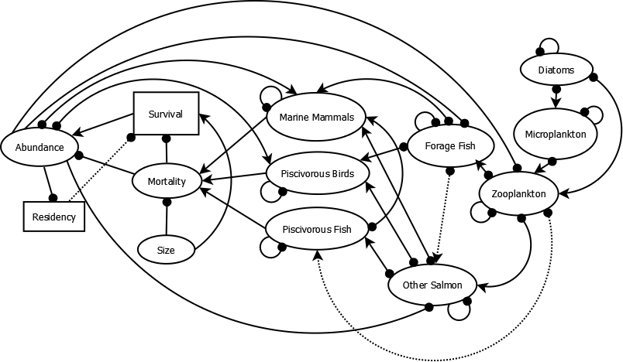
Dia diagram for Salish Sea model
This gets converted to code for the model
Focal responses areas will be treated with simulations
Positive
Negative
Dashed line=Uncertain relationship

Slide 5
An example from Reum et al. 2015 (MEPS)

Slide 6
